Slide 1
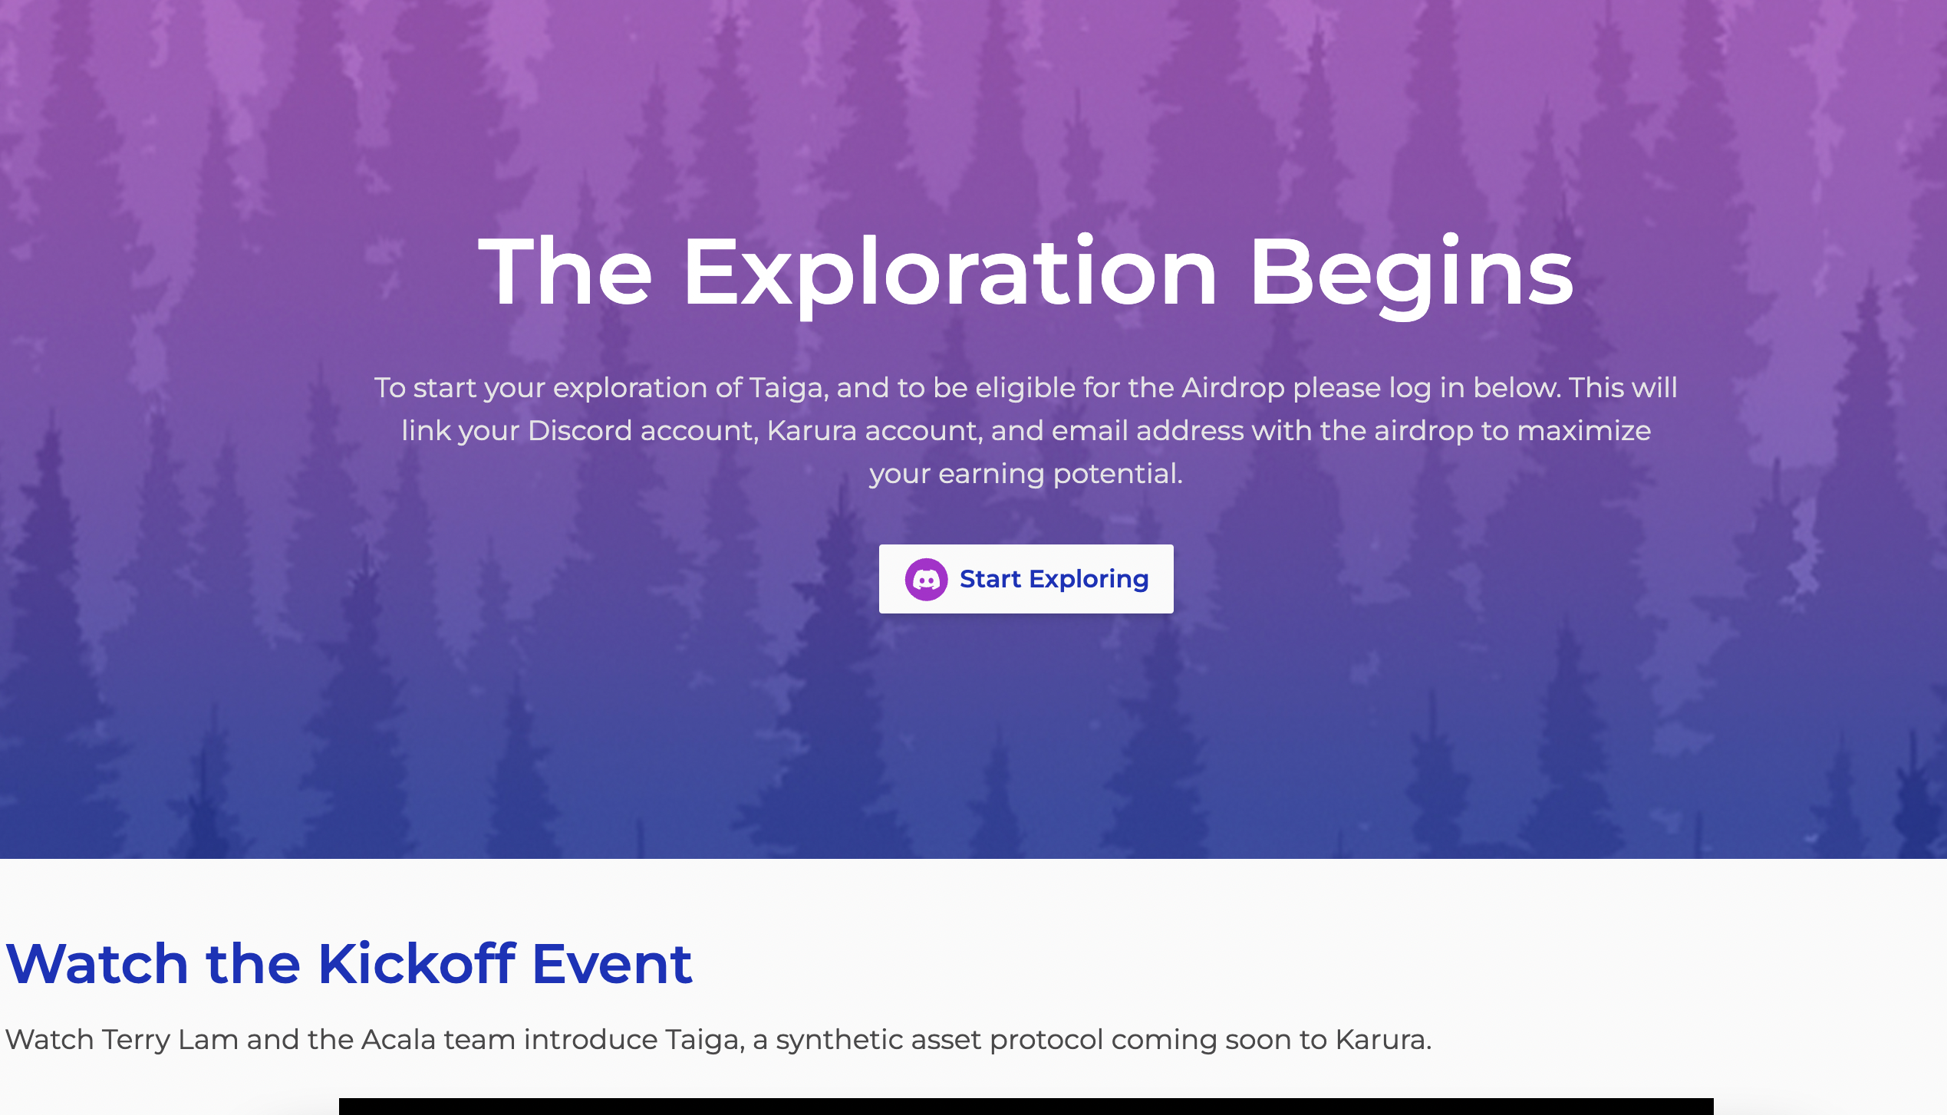
Access the verification website(like a landing page): https://taiga-event-form-j9e63.ondigitalocean.app/
Click the “Start Exploring” button to integrate discord and redirect to verification page

Slide 2
Verification Page example
Discord username(display automatically after intergration)
Karura address
Karura crowdloan address
Newsletter subscribed email
Telegram username
Submit

Slide 3
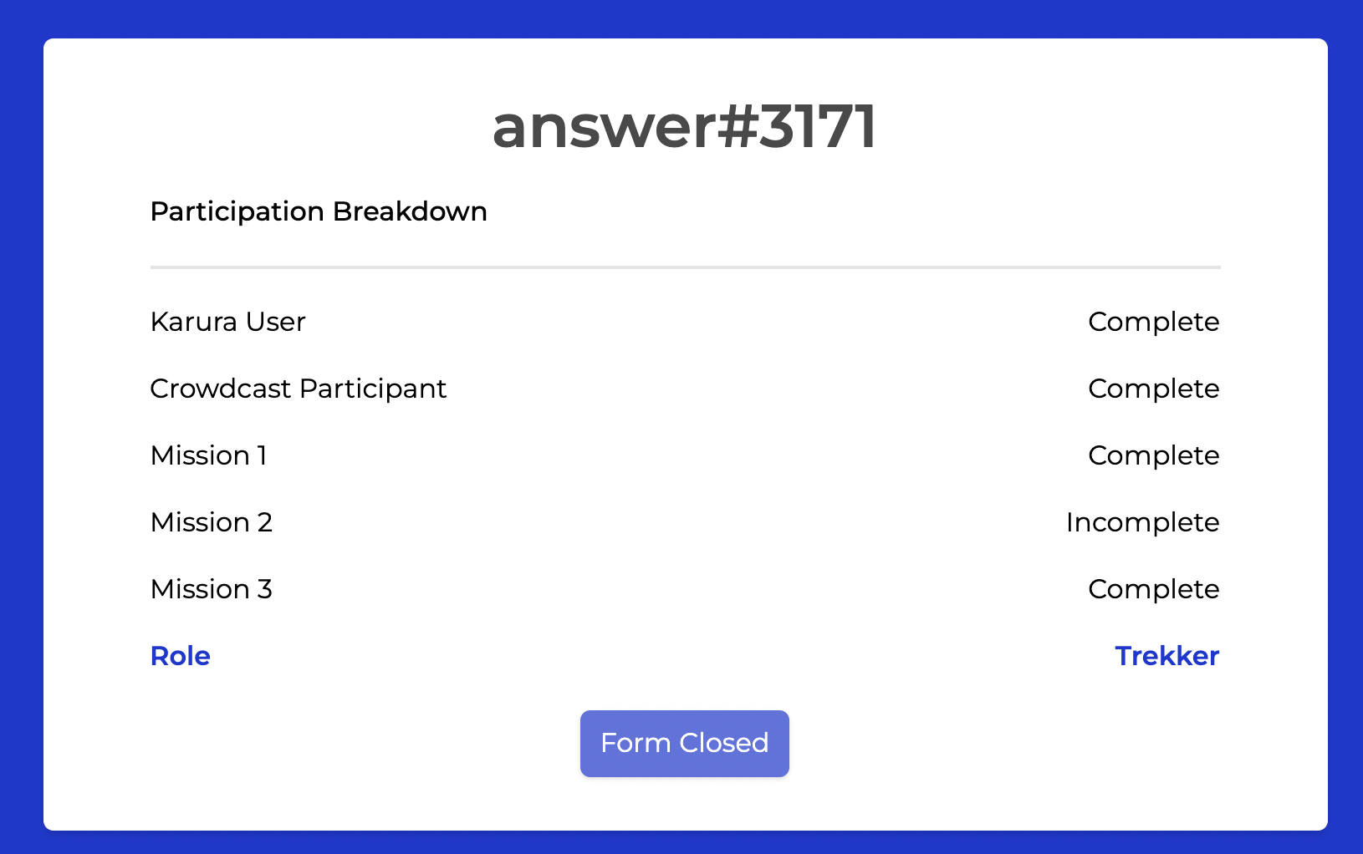
After submitting, redirect to profile page: https://taiga-event-form-j9e63.ondigitalocean.app/profile
The breakdown will change to:
Inaugural Event Airdrop Receivers
Karura User
Karura Crowdlaon Partcipant
Mission 1
Mission 2
(Submit form button to let them update info in the verification page)
***
The first three breakdown no need to display if the user doesn't have
The role will display after the end of event and our verify
Disable the buttom(or display form closed )

Slide 4
Profile page logic:
1. Detect whether the discord id and his karura address(one of them or both) in the Inaugural Event Airdrop Receivers list. If yes, display YES, and no need to display Karura User and Karura Crowdloan Participant breakdown
2. If the user not in the airdrop list, hide the Inaugural Event Airdrop Receivers breakdown. Then detect whether his submitted addresses are in the list of Karura User and Karura Crowdloan Participant(We should have two lists or table including all addresses in advance). If a user meets the criteria, display YES. If not, hide the breakdown
3. Mission 1 and 2 breakdown display to all users. If a user meets the criteria, display Completed. If not, display Imcompleted
4. Mark down how many XP user earned in this event in the database(they have existing XP in the “XP building” sheet).
Mission 1 completed earn 100XP
Mission 1+2 completed earn 300XP
Exclusive 300XP for Karura User
Exclusive 300XP for Karura Crowdloan Participant
Sum up total XP to detect who is Camper(XP>255), who is Trekker(XP>1150)

